Slide 1
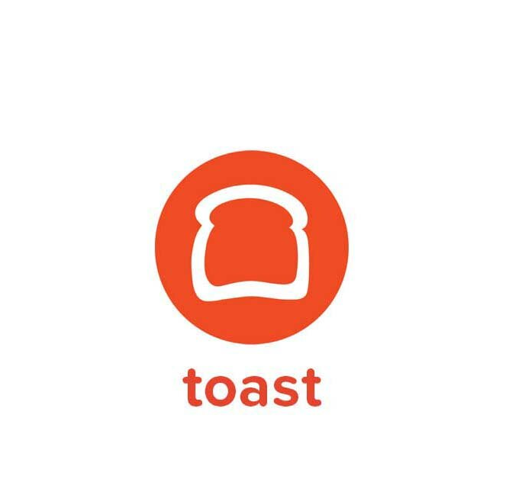
Toast, Inc.
Group -2 Team Members:
Jahnavi Tirumala sitty
Jyothsna Reddy Madireddy
Kanishma Subbiah
Varsha Sri Madusudhanan

Slide 2

INTRODUCTION
Industry Innovator: Boston-based company offering cloud-based POS solutions for restaurants.
Remarkable Growth: Achieved a 40% revenue increase in Q3 2023.
Extensive Reach: Provides services to 93,000 restaurants, including POS and payment processing.
Market Confidence: Valued at nearly $33 billion with a 63% stock increase on NYSE debut.

Slide 3

DATA COLLECTION & PREPROCESSING FOR RESTAURANT POS ANALYSIS
Source of Data: Utilized a comprehensive dataset from Kaggle, reflecting sales and customer metrics from over 10 restaurants during New Year 2022 celebrations.
Dataset Composition: Includes two main tables featuring fields such as RestaurantID, Name, Cuisine, Zone, Order Details, Customer Information, and Ratings.
Preprocessing Steps:
Cleaning: Removed missing values and duplicate records to enhance data quality.
Splitting Data: Segregated compounded information into individual columns for clarity.
Format Standardization: Ensured all entries conformed to a uniform format for consistent analysis.
Finalization: Saved the refined dataset as a new Excel file, ready for analysis.

Slide 4

KAGGLE DATASET SOURCES AND LINKS
Restaurant-Sales-Analysis/RestaurantsDetails.xlsx at main · Ernest-30/Restaurant-Sales-Analysis. (n.d.). GitHub. Retrieved November 9, 2023, from
https://github.com/Ernest-30/Restaurant-Sales-Analysis/blob/main/RestaurantsDetails.xlsx

Slide 5
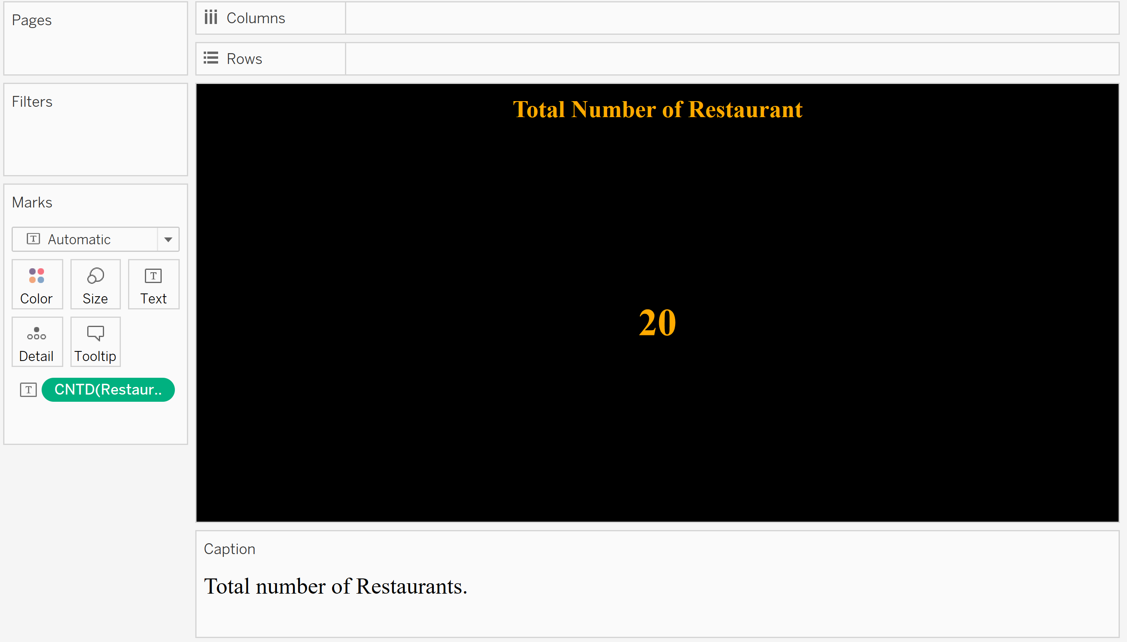
Total number of restaurant Table chart
DATA VISUALIZATION

Slide 6

Total number of Cuisines Table chart

Slide 7
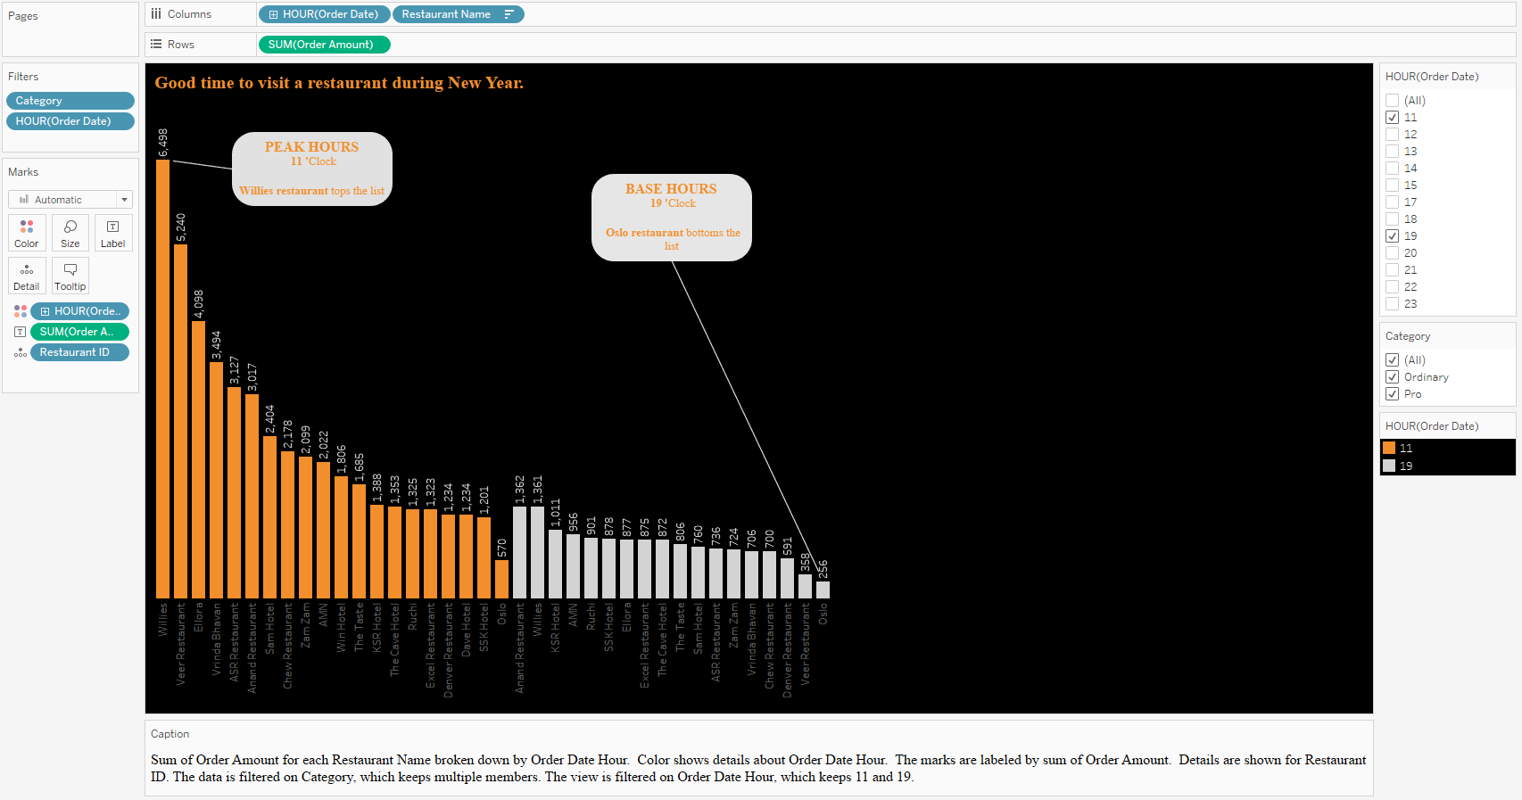
PEAK HOURS ANALYSIS - BAR CHART

Slide 8
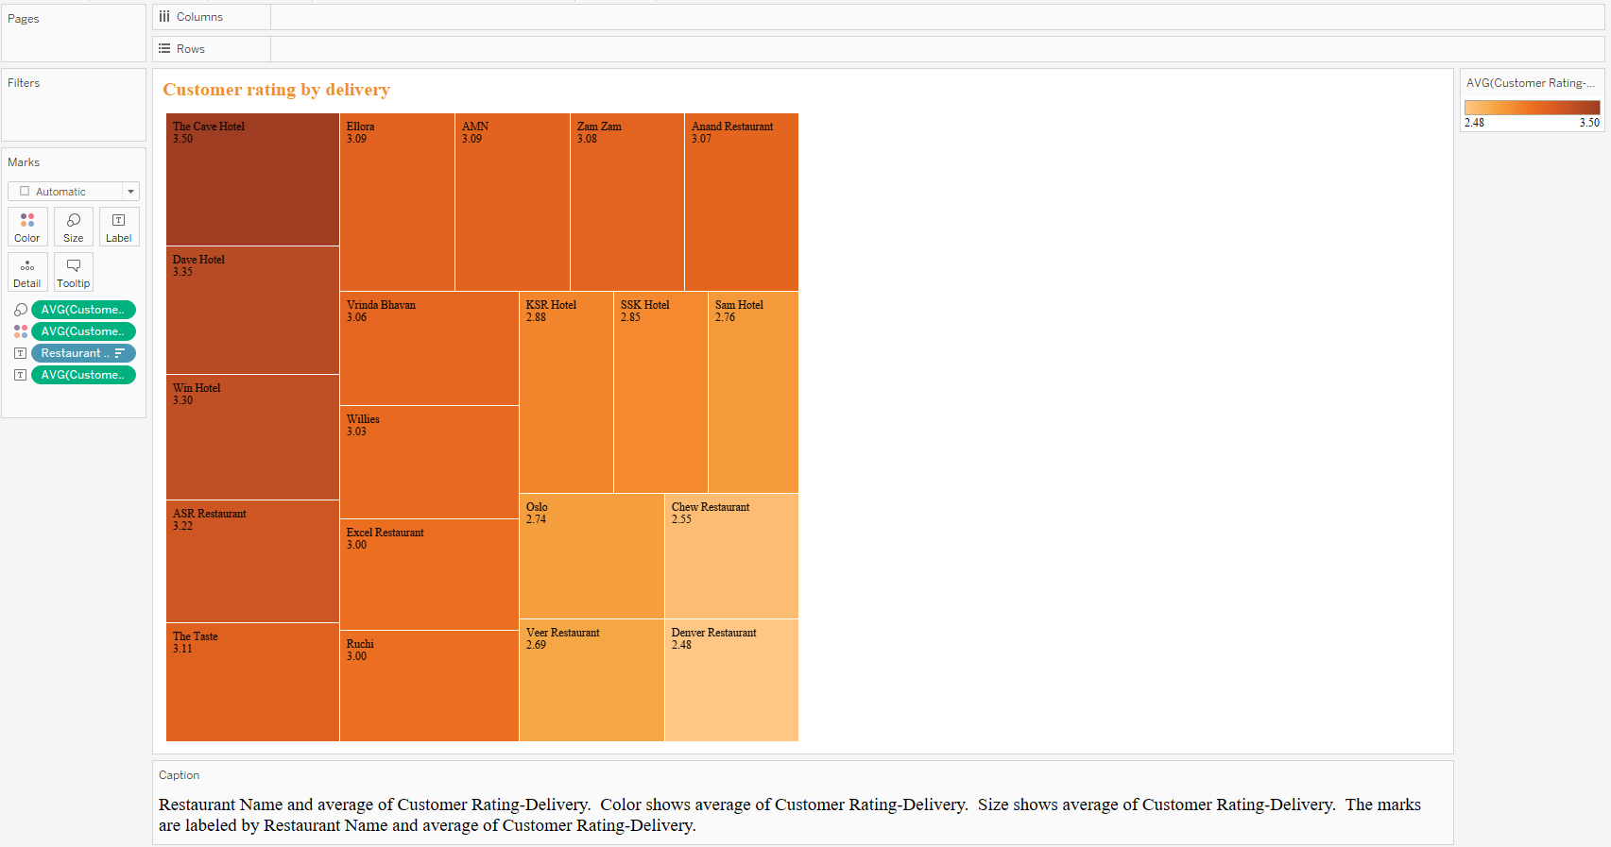
CUSTOMER-RATING BASED ON DELIVERY - TREEMAP

Slide 9
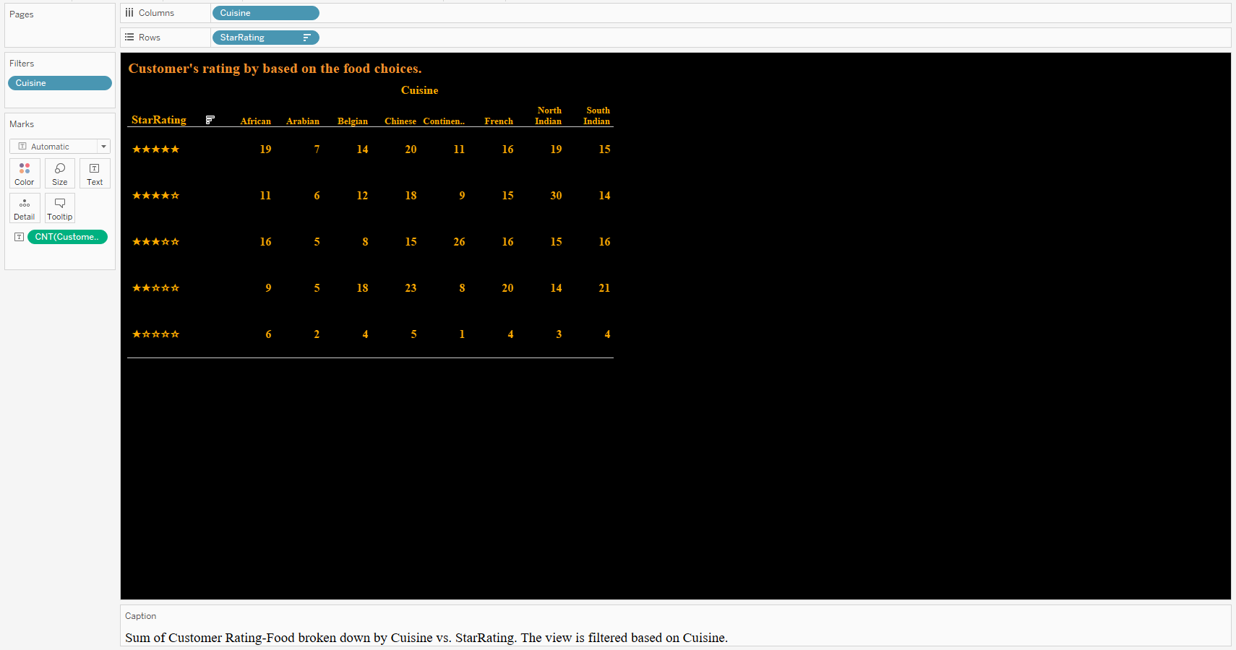
CUSTOMER- RATING BASED ON CUSINES – HIGHLIGHTED TABLE

Slide 10
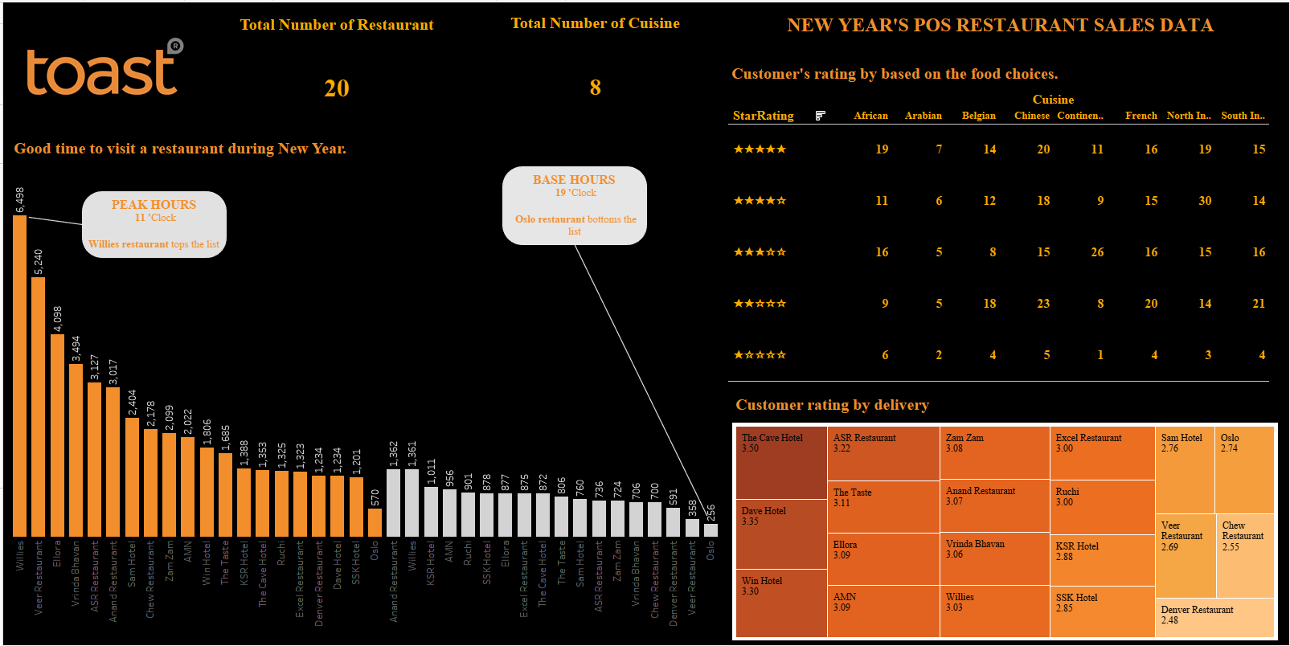
POSRestaurantDashboard – Static

Slide 11

KEY INSIGHTS
Insights Gained:
Order Trends: Identified peak hours for orders, favored cuisines, and order frequency.
Customer Satisfaction: Mapped customer feedback to measure satisfaction levels.
Operational Efficiency: Recognizing areas for improvement, such as optimizing pricing strategies and streamlining operations, will enhance the company's effectiveness.

Slide 12
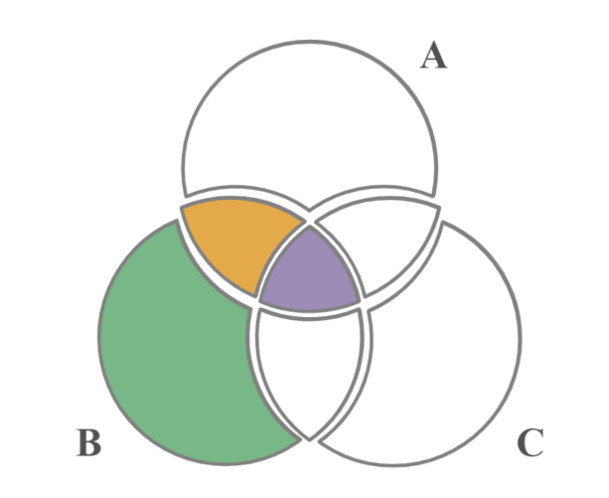
How to find which Zone has many cuisines so that I can have many options to explore?

Slide 13
XENOGRAPHICS
Xeno.graphics is a collection of unusual charts and maps

Slide 14
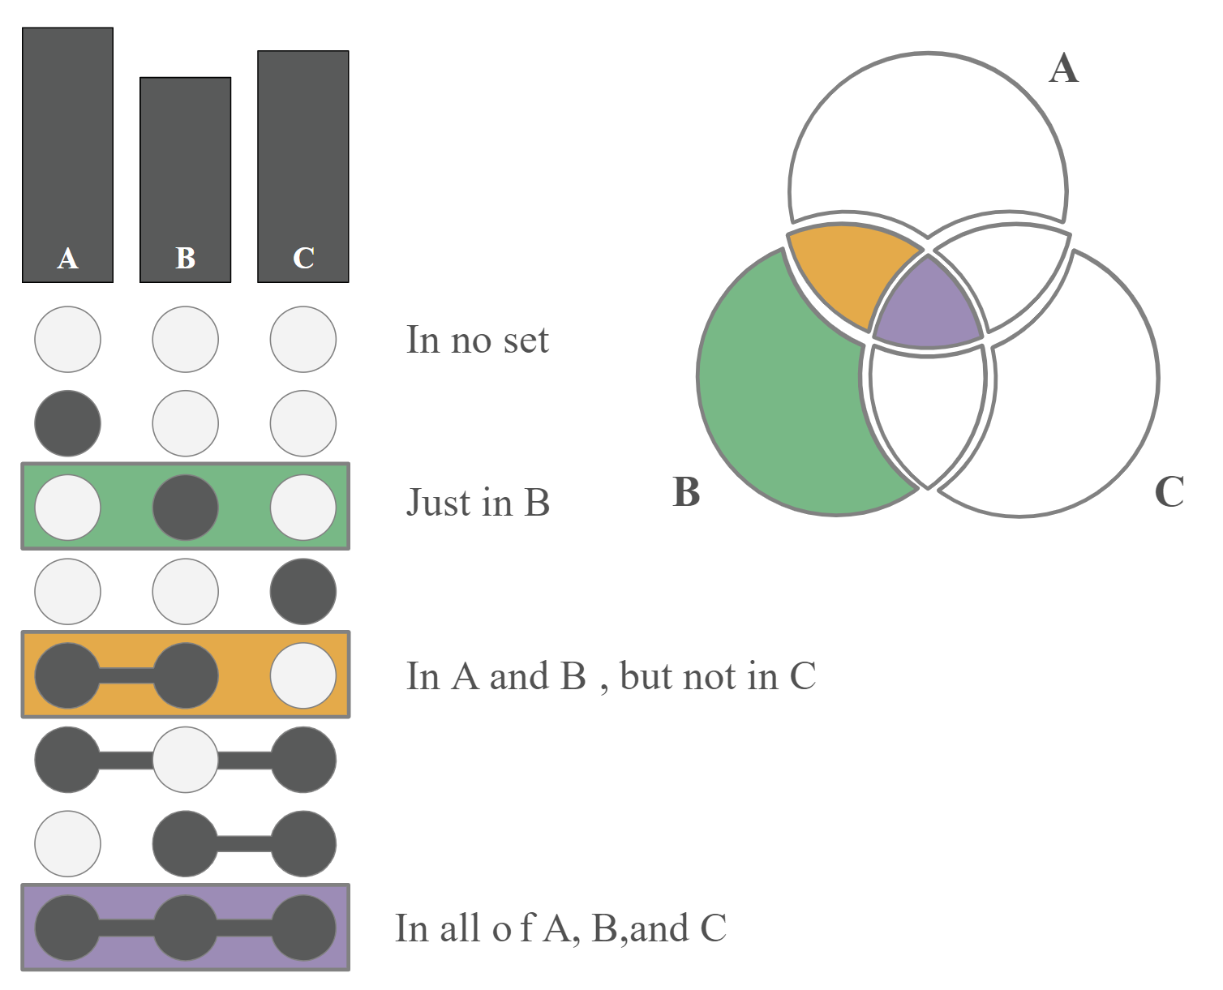
UPSET PLOT
Comprehending the connections among sets is a crucial analytical undertaking. If the number of sets beyond a minor threshold, the main problem in this situation is the combinatorial explosion of the number of set intersections.

Slide 15
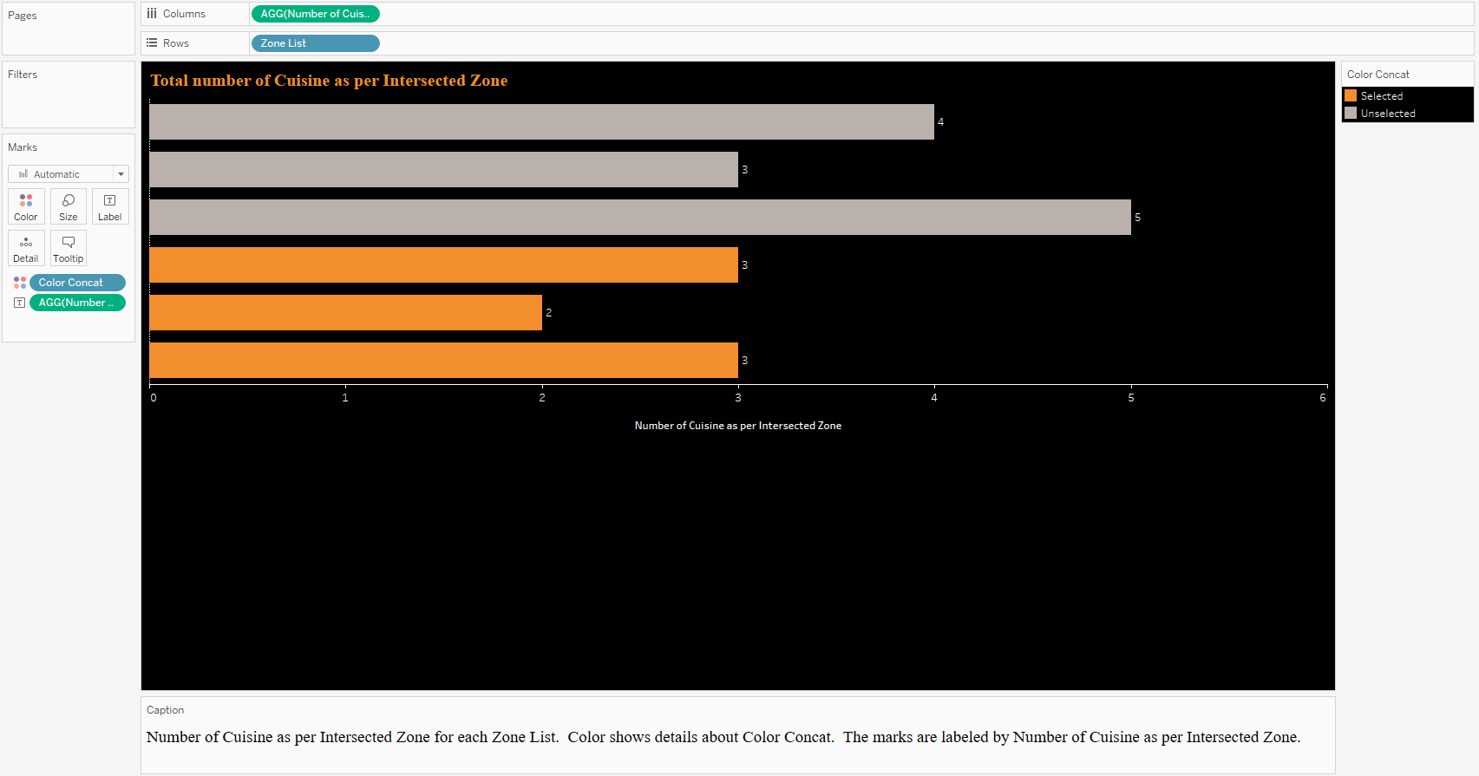
Total number of Cuisine as per Intersected Zone

Slide 16
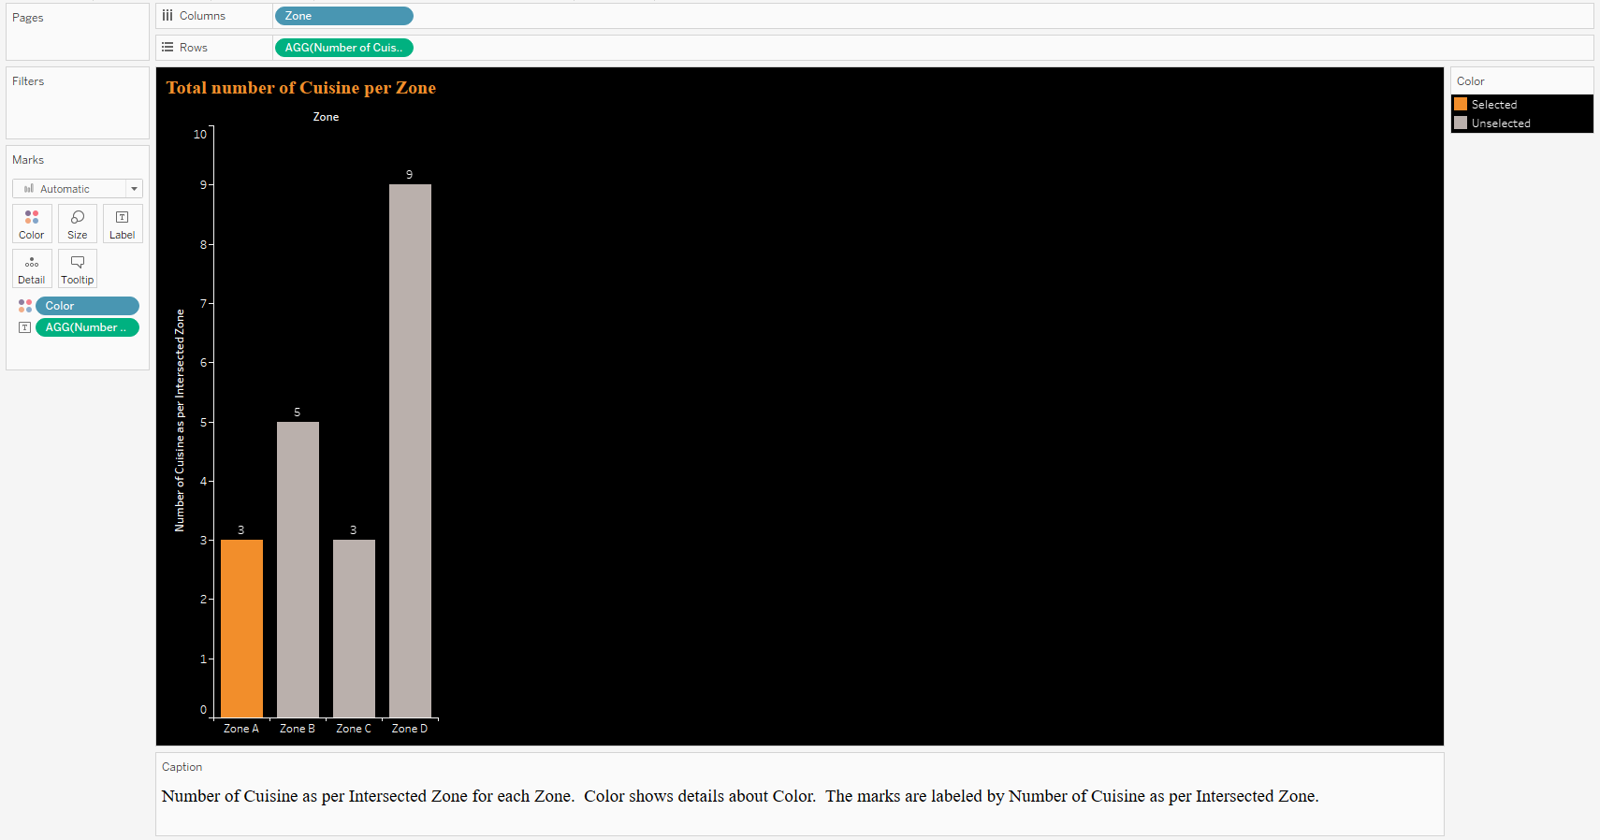
Total number of Cuisine per Zone

Slide 17
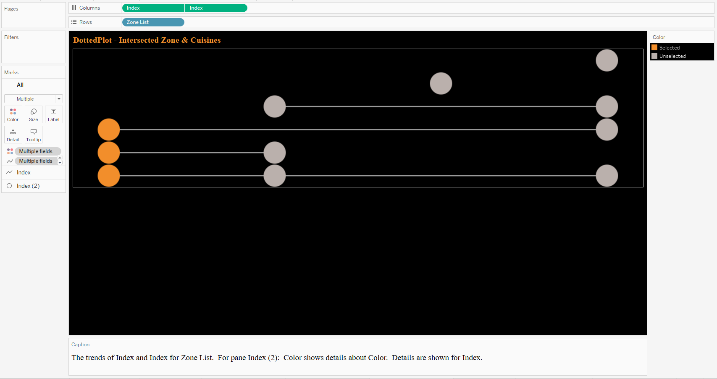
DottedPlot - Intersected Zone & Cuisines

Slide 18
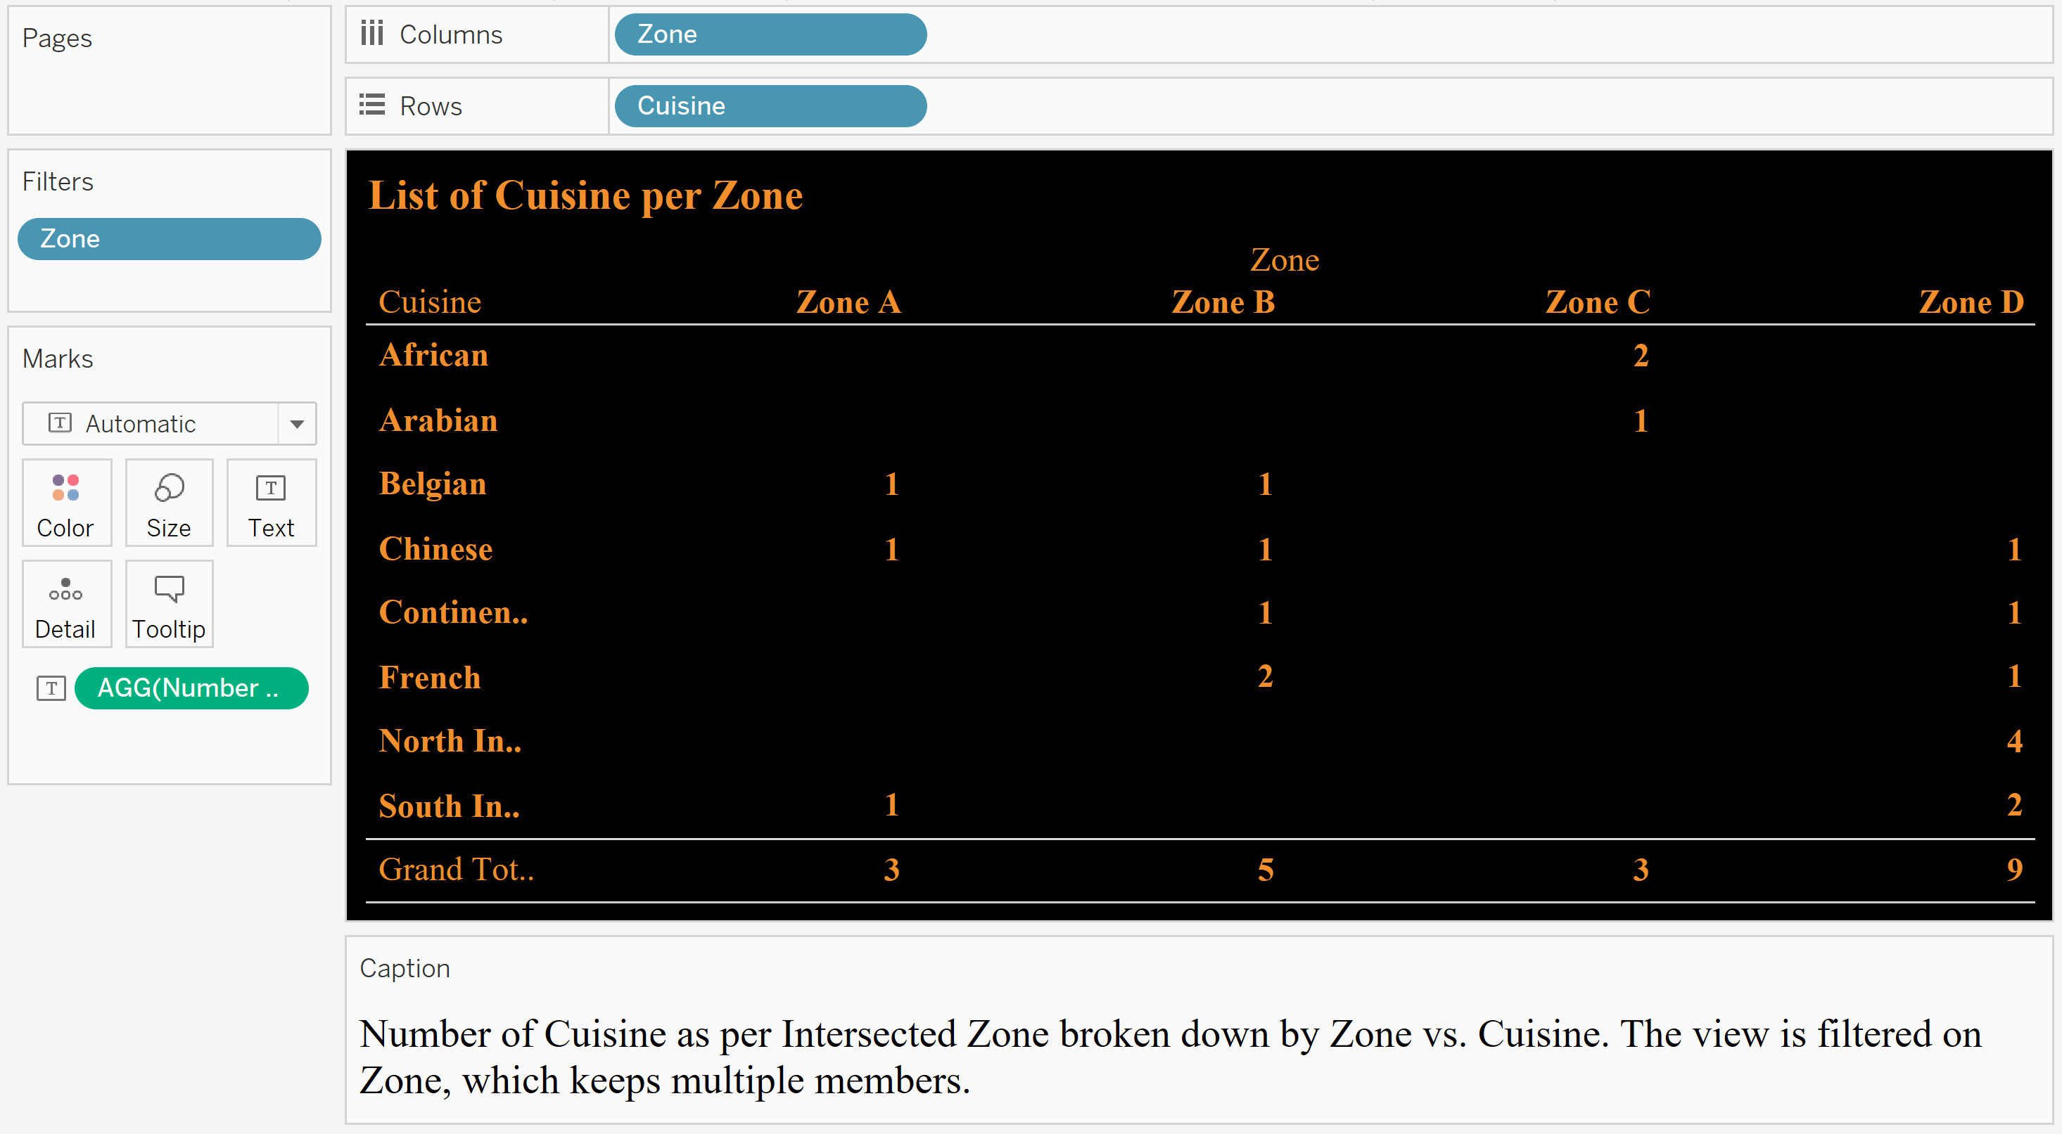
List of Cuisine per Zone

Slide 19
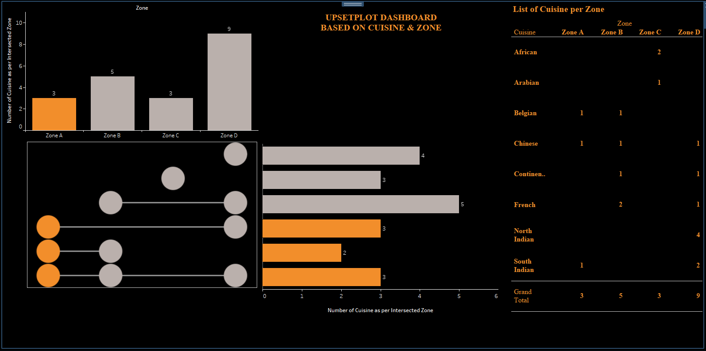
UpsetPlot Dashboard - Based on Cuisine & Zone - Dynamic

Slide 20
DASHBOARD HIGHLIGHTS - RESTAURANT POS DATA INSIGHTS
Peak and Base Hours:
New Year's Rush: Peak orders surged at 11 PM, while 7 PM marked the lowest order activity.
Restaurant Preferences:
Top Choice: Willies emerged as the leading restaurant in sales.
Room for Improvement: Oslo recorded the least preference among customers.
Cuisine Ratings:
Customer Favorite: The table shows that the cuisine with the highest average rating is Chinese,
followed by North Indian and African
Needs a Boost: The cuisine with the lowest average rating is Continental, followed by Arabian and North Indian.
Delivery Service Ratings:
Delivery Champion: The Cave restaurant led the pack with top delivery service ratings.
Zone with many food choices:
Zone and Cuisines: Customers can find where they can find more food options if they didn’t like a particular cuisine.

Slide 21
BUSINESS INSIGHTS AND RECOMMENDATIONS FOR THE DATASET.
Recommendations
Tailored Services: Align services with peak times and popular cuisines.
Enhanced Customer Experience: Address areas with lower ratings.
Optimized Operations: Streamline processes to improve efficiency.
Competitive Edge: Securing Toast's leadership in the restaurant tech space by benchmarking performance and fine-tuning plans with business intelligence.
Zone D Focus: Improve eating experiences by modifying relationships, marketing, and cuisines to attract more customers and ensure long-term success.
Market Adaptability: Utilize trends for continuous service enhancement.

Slide 22


